Slide 1
Software QA and Testing with Automation using Selenium IDE Course 1, Class 2 Deck 2
Instructor
David F Wagoner
PMP, CSQE, CMQ/OE

Slide 2
Types of Testing
Black-box and White-box and Gray-box Testing
Black-box refers to testing with little to no knowledge of the internal structure or coding
White-box refers to the tester having intimate knowledge of structure, coding and logical paths of execution and leverages that knowledge to exercise the system; much like a programmer unit testing
Gray-box refers to a mix of the two, which is preferred. In an open development environment, the better sharing of information from html coders with web site testers, the better.

Slide 3
More on Types of Testing
Documentation
Testing documentation is not limited to user manuals
It becomes even more important with content rich systems such as web pages and sites
Performance
Performance testing refers to a system responding correctly within acceptable response times
Web sites are connected to one or more servers for data, images, other processing and a host of other functions like web services
The performance of the system is measured comprised of these base measures
Client-side time to compile the request (message and data)
Transition time to Server
Server-side processing time
Transmission time to client
Client-side time to handle and display response

Slide 4
More on Types of Testing
Usability
Usually given short-shrift until web sites became pervasive in the late 1990s
More abstract than other types of testing that can rely on concrete attributes and behavior (e.g. links, fields, text)
Difficult to state what is ‘more useable’ than something else

Slide 5
Web Site Testing (cont.)
Usability
This has become and will continue to become an important aspect of web site testing
Jaded web users have fairly strict expectations of web pages and will navigate away from poorly designed sites (manic, lacking flow)
Even the most novice or technophobe users have strong opinions as to site and page layout
The textbook provides a good set of guidelines

Slide 6
Web Page Testing
Differs from traditional Systems testing of computer applications
Content-oriented
Is it the correct content?
Is the content correct?
Visually-oriented
Do graphics, text and active content (video, audio) display correctly and flow properly down and across the screen?
When the screen is resized do these elements retain the flow and adapt?
This is a limiting factor in automating web site testing
Event-based (dynamic) behavior
Is the correct behavior invoked?
Is the behavior correct? Is it doing the right thing based on event attributes or data?
There can be many forms of dynamic behavior based on actions as innocuous as a pointer hovering on an object, that are event-based

Slide 7
Web Page Testing (cont.)
Differences (cont.)
Links
Do links function correctly (all states – hover, click, right click should correct shadings and colors?
Do they link correctly to other content?
If the content is external, it may change and require repetitive testing for every release

Slide 8
Web Site Testing (cont.)
Handicapped Accessibility
Most sites are public-facing and should be instrumented for handicapped accessibility using ALT tags to portray information for the blind or near blind users, those using voice recognition due to other disabilities…etc.
These too need to be tested. They become more important to address given the wide spread uses of many sites to government functions, portals and pervasive social media
It’s often ignored for many web site development teams
Section 508c covers the federal regulation for web sites based on the 1978 ADA
http://www.access-board.gov/guidelines-and-standards/communications-and-it/about-the-section-508-standards/guide-to-the-section-508-standards

Slide 9
Web Site Testing (cont.)
Forms and Fields
Despite being content rich apps, there are still forms and fields to be tested
Do they accept the correct ranges of values?
Login and password
Email addresses
Text Fields
List boxes
Database Servers
Web pages that have forms and fields will use a database server with a specific database schema and data to validate data and take appropriate action (e.g., file an online order, fetch membership information to permit your logins…etc.)

Slide 10
Web Site Testing (cont.)
Platform and Browser Testing
Typically this is concerned with the difference between Windows and Linux based systems
Also typically concerned with testing against various browsers such as IE, Mosaic, Firefox, Safari…etc., each which maintain varied levels of compliance to html standards, increasing the complexity of the task
Now this also means sites must develop to and deploy to and test to mobile devices whether Apple or Android or Windows based

Slide 11
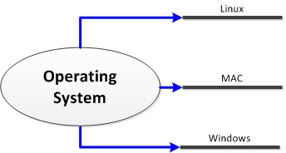
The ‘Old’ Days (1995-~2005)

Slide 12
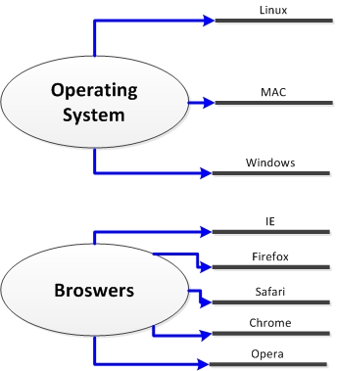
A Simpler Time

Slide 13
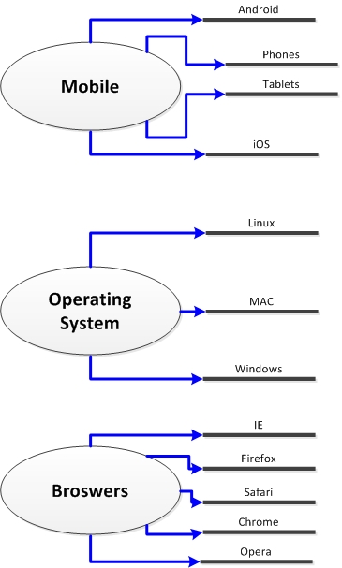
Today’s Complexity

Slide 14
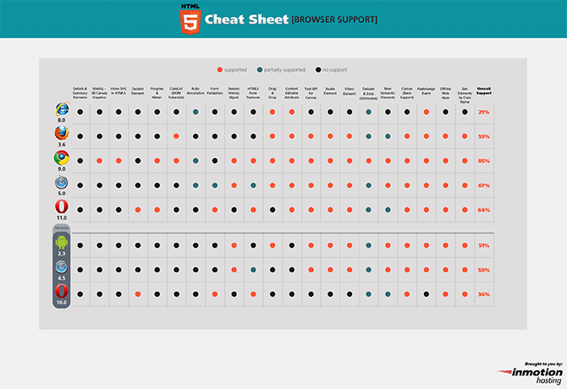
Web Site Testing (cont.)
Many online resources to identify browser compatibility and test a browser to detect compatibility
http://caniuse.com/; http://mobilehtml5.org/; http://html5readiness.com/

Slide 15
Web Site Testing Heuristics
Gratuitous use of new tech
Moving graphics or audio
Long pages
Non-standard link colors (states)
Outdated info
Long upload/download times
Poor Navigation
Link Rot
Overly Complex Anything (visuals, addresses, links)

